Slide 1
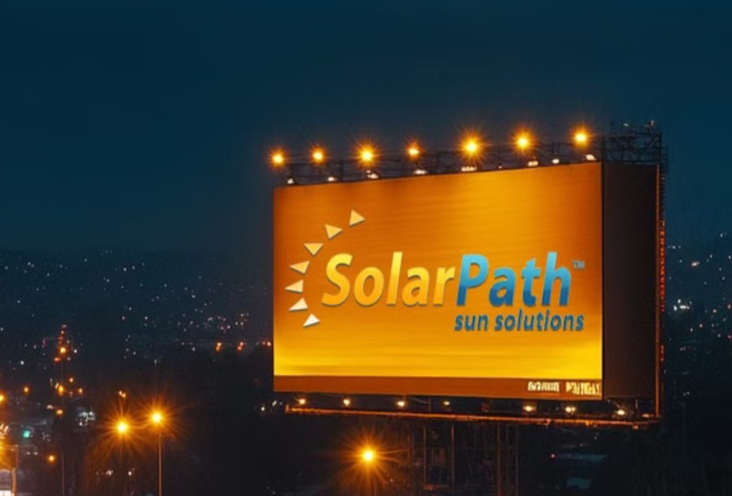
LIGHTDECO SOLATILE2 Specifications

Slide 2

Why us?
SOLATILE II
Innovative Technology
SolarPath is dedicated to delivering architectural and commercial-grade solar lighting that can be customized to meet specific client requests, both in technical specifications and aesthetic design, ensuring a perfect fit for a diverse range of needs.
High-efficiency solar and advanced LEDs deliver superior performance, long life, and maximum ROI.
Photometric
We conduct photometric measurements on all our products to ensure optimal performance and compliance with industry standards
Versatile Lightning
We designs and install solar-powered lightning systems tailored for all kind of locations such as streets, parks, pathways, homes, etc.
Global Reach
Worldwide success proves our adaptability and regulatory
expertise.
Sustainable Savings
These solutions enhance safety, promote sustainability and providing significant energy and cost saving.
Warranty
2/7

Slide 3
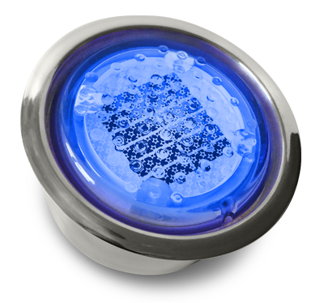
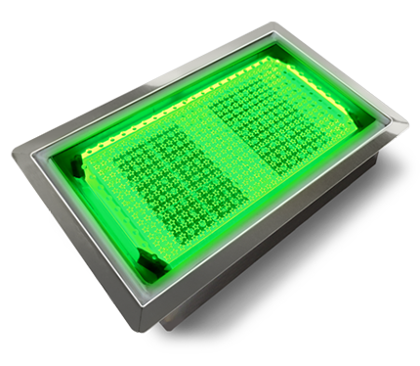
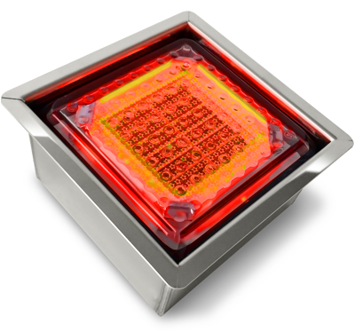
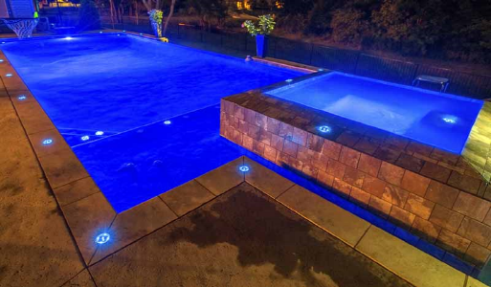
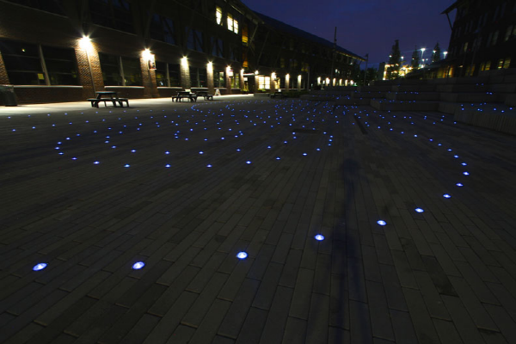
SOLATILE II
SolaTile I I is the news generation of Solarpath light emitting tiles. The design is an example of our value of listening and responding to the insight and wish list of lighting designers, architects, public artist and our other partners.
The member of the LightDeco series engages an open surface photovoltaic array laid in a recessed chamber.
LED light, driven by clean capacitor power, are placed in the corners of a full-face illuminating plate. When the plate is lit, the recessed solar array is hidden, and the entire surface of the SolaTile II becomes fully illuminated.
Branding enhancements through customization are unlimited. Through advanced laser etching any design can be impressed upon the illuminating plate, allowing for the highlighting of emblems, logos, demarcations, symbols, pictures and lettering on the unit surface.
3/7

Slide 4
SOLATILE II
Technical specification
Operation
Solar panel type | Mono-Crystalline
Illumination technology | Ultra-bright LEDs
Energy storage | Ultra-Capacitors
Charging time | 2 Hours (sunny) to 8 Hours (cloudy or rainy)
Operation at full charge | Up to 16 hours
Colors | Red, Green, Blue, Orange, Amber, White
Operating temperature | 140 °F to -13 °F / 60 °C to -25 °C
Automatic On/Off level | 150 lux - 350 lux
Light Properties
Color | Luminance (Nit) | Illuminance (Lux) | Uniformity
Red Green Blue Orange Amber White | 6.8 6.5 17.3 16.4 4.7 4.5 6.3 5.9 3.4 3.2 13.2 12.5 | 21.6 20.5 54.2 51.4 14.8 14.1 19.9 18.7 10.8 10.1 41.5 39.3 | 90% 80% 90% 80% 90% 80% 90% 80% 90% 80% 90% 80%
Material and Design
Case Material | UV-Treated polycarbonate (main body)
Available Sizes | L. Square - 8"W x 8"L x 2.54"H S. Square - 4"W x 4"L x 2.54"H Rectangular - 4"W x 8"L x 2.54"H Round - Ø4" x 2.54"H
Weight | L. Square – 5.5lbs / 2.5kg S. Square – 1.3lbs / 0.6kg Rectangular – 2.2lbs / 1kg Round – 1.2lbs / 0.5kg
Modulus of rupture | 21.8 Nirnm2 (=222 kgf/cm2)
Compressive strength | 2.74 N/mrn2 (=28 kgficin2)
Breaking load | 34.888 N (=3.560 kgf)
Waterproof | IP 68 - 100% (submersible)
4/7

Slide 5
SOLATILE II
SOLAR STREET LIGHT
USES AND APPLICATIONS GUIDE
Driveways
Landscaping
Pool decks
Pool bottoms
Patios
Fountains
Walkways
Boardwalks
Building exteriors
Stairways
Pavers
5/7

Slide 6
SOLATILE II
ORDERING GUIDE
Ordering Guide: EXAMPLE: SOLATILE2-A-8X8
Model | LED Color | Size
SOLATILE2 | A – Amber W – White B – Blue R – Red G – Green Y - Yellow O - Orange | 8X8 4X8 4X4 4R (Round)
Legal Clarification: All technical information and/or products listings and/or technical support, and/or any kind of graphics, illustrations and/or instructions and/or the names, trade names, trademarks, trade symbols, service marks, logos, icons and trade dress of SolarPath Inc or in connection to SolarPath Inc or any of its selling products, con- tainted herein is in the exclusive ownership of SolarPath Inc and may not be alternated and/or used in any manner including but not limited to copy of some or all of the said material by users and/or viewers or any third party for that matter of this document and the website to which it is linked without the express prior written permission of SolarPath Inc. Furthermore, redistribution or any kind of commercial use or alternation or any kind of use other then downloading presented information in some or all contents of downloadable documents, and/or downloadable contents, is strictly prohibited without express written prior permission. All information set out herein is subject to changes as may occur from time to time. SolarPath Inc is not responsible for, and cannot guarantee and shall not be held liable for any information or the accuracy of such in websites that it does not manage
6/7

Slide 7

Contact us
+1.201.490.4499
Toll free: 1.888.333.SOLAR (7652)
contact@solarpathusa.com
www.solarpathusa.com
7/7

