Slide 1

LIGHTDECO RIGEL 60 Specifications

Slide 2

Why us?
RIGEL 60
Innovative Technology
SolarPath is dedicated to delivering architectural and commercial-grade solar lighting that can be customized to meet specific client requests, both in technical specifications and aesthetic design, ensuring a perfect fit for a diverse range of needs.
High-efficiency solar and advanced LEDs deliver superior performance, long life, and maximum ROI.
Photometric
We conduct photometric measurements on all our products to ensure optimal performance and compliance with industry standards
Versatile Lightning
We designs and install solar-powered lightning systems tailored for all kind of locations such as streets, parks, pathways, homes, etc.
Global Reach
Worldwide success proves our adaptability and regulatory
expertise.
Sustainable Savings
These solutions enhance safety, promote sustainability and providing significant energy and cost saving.
Warranty
2/7

Slide 3
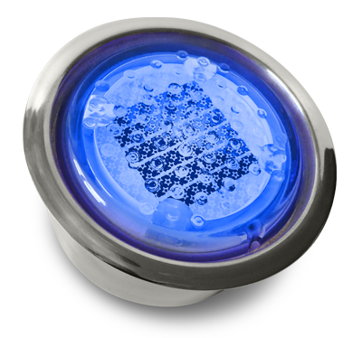
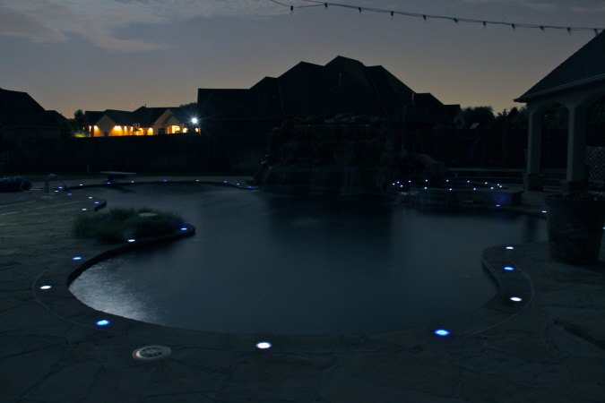
RIGEL 60
Rigel 60 engages a photovoltaic array laid in a perimeter-style orientation along the edges of the tile surface. The square enclosure centers on an opaque diffusive plane, through which colors are horizontally diffused. The effect is the creation of small square pools of light.
Rigel 60 continues to exceed expectations many years after its initial development. Used in residential, public, commercial, and industrial design, the unit has weathered all environments faultlessly. It is an original, dependable, and unique addition to any lighting design.
3/7

Slide 4
RIGEL 60
Technical specification
Lighting Technology | Active photovoltaic LED
Dimensions | R64 x H40mm
Weight | .39lbs
Housing Material | Solar Cell &I.C (Integrated Circuit) covered with U.V. coated Polycarbonate (Super-intensity)
Out Case | Stainless Steel Housing
LED’s | 4Pcs
LED color | Yellow/ Red/ White/ Blue/ Green
LED output | 5000 mcd
LED output frequency | Steady or Flashing
LED visibility | 1640 feet
Activation | Photo Sensor
Storage Device | Li-FePo4 ion battery
Capacitor cavity | 600 m Ah/ 3.2V
Strength | 50400lbs/in
Charge Condition | Sunny Day-2hr Rainy Day- 8hr
Life Span | Li-FePo4 ion battery for 2,000 cycles
Lighting time | 12-16hrs
Waterproof | IP 68
Output on full charge | Up to 11-12 Hours
Operating Temperature | -40F to 176F
Manufacturer’s Warranty | One Year
4/7

Slide 5
RIGEL 60
SOLAR STREET LIGHT
USES AND APPLICATIONS GUIDE
Driveways
Landscaping
Pool decks
Pool bottoms
Patios
Fountains
Walkways
Boardwalks
Building exteriors
Stairways
Pavers
5/7

Slide 6
RIGEL 60
ORDERING GUIDE
Ordering Guide: EXAMPLE: RIGEL60-CA-F0
Model | LED Color | Flashing Pattern
Rigel 60 | CA – Amber CW – White CB – Blue CR – Red CG – Green CY - Yellow | F0 – Steady F1 – Flash 60 F2 – Flash 120 F3 – Fade Flash
Legal Clarification: All technical information and/or products listings and/or technical support, and/or any kind of graphics, illustrations and/or instructions and/or the names, trade names, trademarks, trade symbols, service marks, logos, icons and trade dress of SolarPath Inc or in connection to SolarPath Inc or any of its selling products, con- tainted herein is in the exclusive ownership of SolarPath Inc and may not be alternated and/or used in any manner including but not limited to copy of some or all of the said material by users and/or viewers or any third party for that matter of this document and the website to which it is linked without the express prior written permission of SolarPath Inc. Furthermore, redistribution or any kind of commercial use or alternation or any kind of use other then downloading presented information in some or all contents of downloadable documents, and/or downloadable contents, is strictly prohibited without express written prior permission. All information set out herein is subject to changes as may occur from time to time. SolarPath Inc is not responsible for, and cannot guarantee and shall not be held liable for any information or the accuracy of such in websites that it does not manage
6/7

Slide 7

Contact us
+1.201.490.4499
Toll free: 1.888.333.SOLAR (7652)
contact@solarpathusa.com
www.solarpathusa.com
7/7

