Slide 1

HIGHLIGHT SP-OPTS Specifications

Slide 2

Why us?
HIGHLIGHT SP-OPTS
Innovative Technology
SolarPath is dedicated to delivering architectural and commercial-grade solar lighting that can be customized to meet specific client requests, both in technical specifications and aesthetic design, ensuring a perfect fit for a diverse range of needs.
High-efficiency solar and advanced LEDs deliver superior performance, long life, and maximum ROI.
Photometric
We conduct photometric measurements on all our products to ensure optimal performance and compliance with industry standards
Versatile Lightning
We designs and install solar-powered lightning systems tailored for all kind of locations such as streets, parks, pathways, homes, etc.
Global Reach
Worldwide success proves our adaptability and regulatory
expertise.
Sustainable Savings
These solutions enhance safety, promote sustainability and providing significant energy and cost saving.
Warranty
2/12

Slide 3


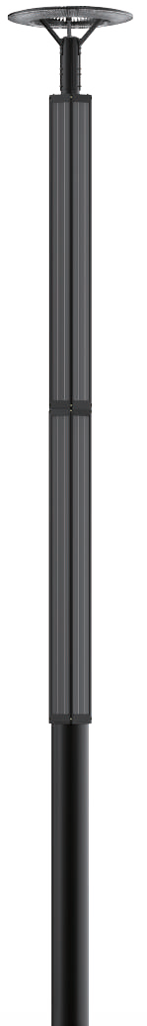
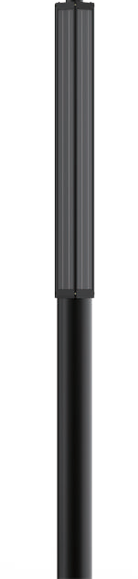
HIGHLIGHT SP-OPTS
The SolarPath HIGHLIGHT SP-OPTS™ is the premier LED solar illumination technology in its class today. Ultra-bright/High Intensity LED lighting means a total lighting solution for any need. The solar panel is wrapped and can be installed on a new or an existing pole. It is new technology. This product has both a solar engine and a LED light. The battery and controller are inside pole which allow this product to be used for, roads, parking lot, pathway, etc. The lighting fixture can be used up to 80W and can be controlled via remote control.
3/12

Slide 4
HIGHLIGHT SP-OPTR
Technical specification
Solar Module Parameters | Type | High-efficiency Monocrystalline Silicon
 | Power | Up to **560W / 1200W
Solar Charge Controller | MPPT (Maximum Power Point Tracking), infrared solar charging controller
Battery | LifePO | Up to 90AH
LED Light Parameters | Light Source Power | Up to 80W (Up to 13,000 lm)
 | CCT (Correlated color temperature) | 3,000K-6,000K/ Amber
 | CRI (Color rendering index) | ˃81
Control Modes | Manual ON/OFF / Automatically ON/OFF / Time Control
CCT | Depend on installation area, can be programed with remote control
IP Rating | IP67
Product Size | Light Body | Depend On LED power
 | Solar Panel | Depend On Solar Panel wattage
Net Weight | Light Body | Depend On LED power
 | Solar Panel | Depend On Solar Panel wattage
19.29”
4.44”
3.93”
Ф 2.99"
4/12

Slide 5
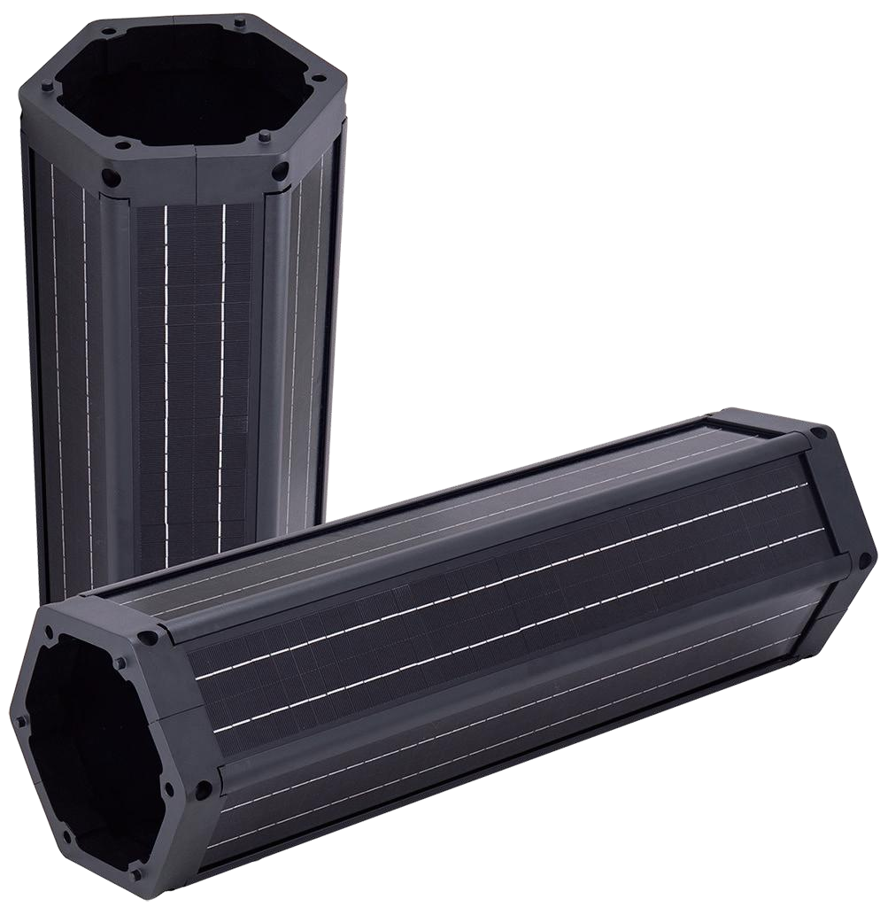
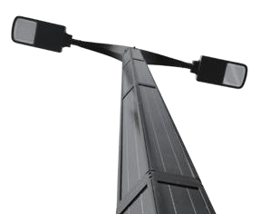
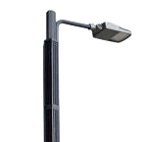
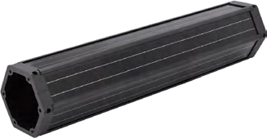
HIGHLIGHT SP-OPTP
Vertical Solar Module
Main Specification
Model | VSP-140 | VSP-200
Specification | 140W 18V/36V MONO | 200W 18V/36V MONO
Dimension | 8.97”*7.87”*61.41” | 8.97”*7.87”*81.10”
Pole diameter | 2.95”~5.51” | ●
Cell efficiency | 22.5% | ●
Structure material | UPVC + aluminum alloy | / aluminum alloy
Lifetime | >20 years lifetime
Warranty | 5 years
5/12

Slide 6
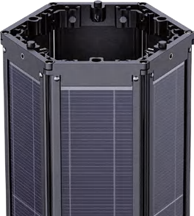
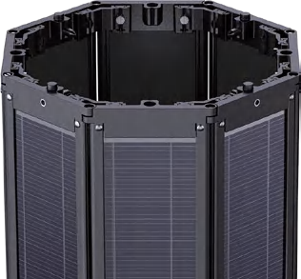
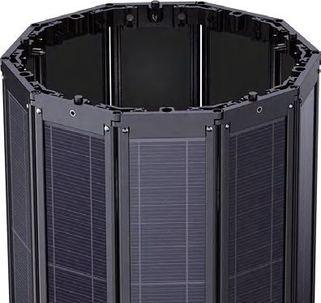
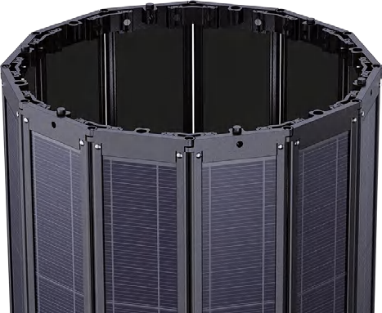
HIGHLIGHT SP-OPTR
GeoFlex/ Polygonal Photovoltaic Module
The GeoFlex Series features a foldable polygonal solar panel design, adaptable to shapes like hexagons or octagons for customizable power output. Its foldable structure reduces packaging volume by over 50%, lowering international shipping costs. With a modular design, it easily expands for higher power needs, while 360-degree charging ensures maximum sunlight capture.
The vertical cylindrical panels provide superior wind resistance and a sleek, urban-friendly design that prevents snow accumulation and enhances durability. Ideal for solar streetlights, surveillance systems, and traffic signals, the GeoFlex Series combines functionality, efficiency, and seamless urban integration.
A
A
C
C
Hexagon
B
B
OCTAGON
8 Sides
A =10.62” B =11.41” C =7.48”
HEXAGON
6 Sides
A =8.85” B = 7.71” C =4.72”
A
Octagon
A
C
C
B
B
Decagon
DECAGON
10 Sides
A = 14.17” B = 13.38” C = 10.23”
DODECAGON
12 Sides
A = 16.14” B = 16.73” C = 12.99”
Dodecagon
6/12

Slide 7
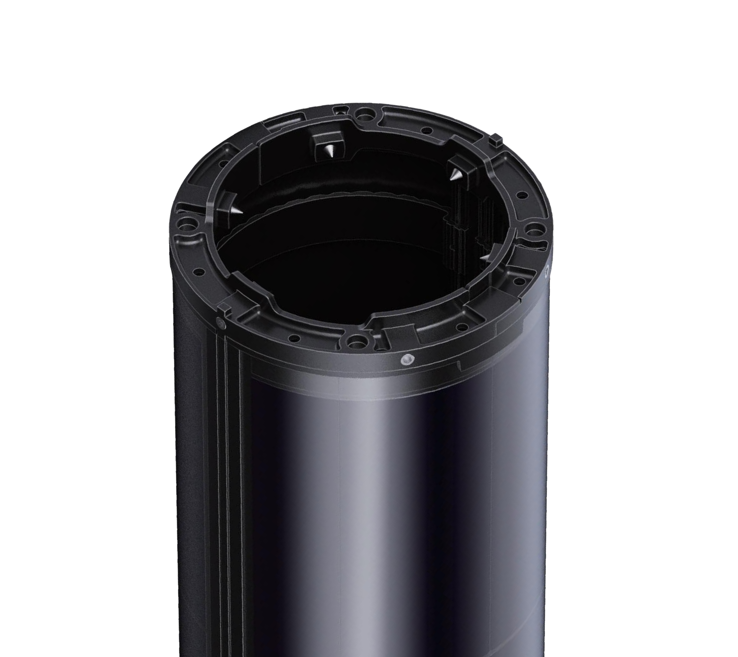
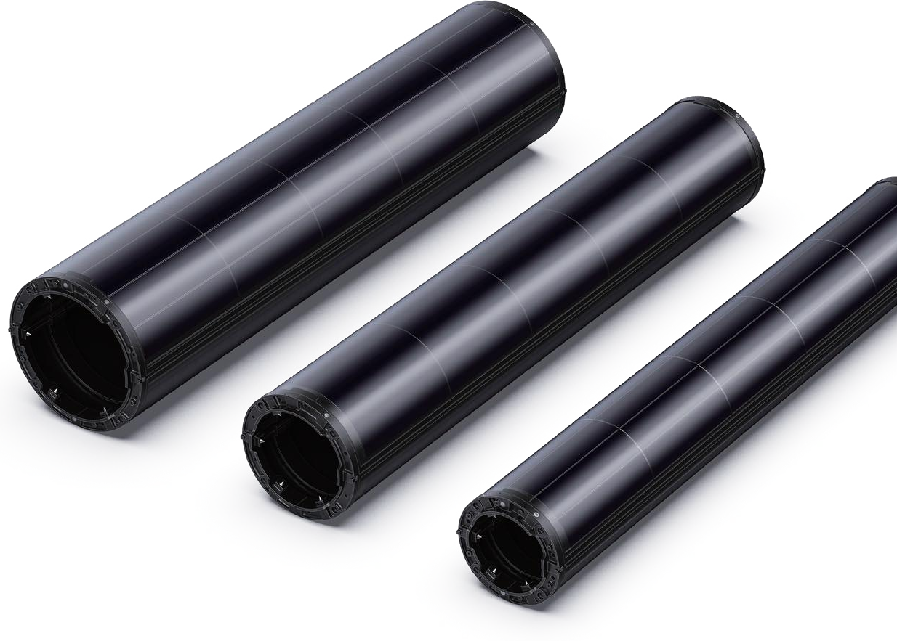
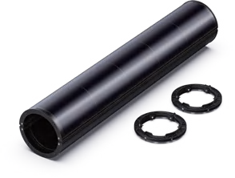
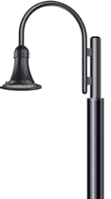
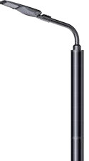





HIGHLIGHT SP-OPTR
Vertical Solar Tube
80W I 100W I 140W
Designed in U.S.A and assembled in P.R.C, SolarWrap vertical solar cylinder represents an innovative solution tailored for pole-mounted Applications. Distinguished from conventional solar panels, poles equipped with the SolarWrap cylinder exhibit exceptional aesthetic appeal, seamlessly integrating into serene environments while retaining the appearance of traditional poles, albeit enhanced with beauty. Its versatility extends to various Applications including solar light poles, solar camera poles, and solar traffic signs.
Main Specification
Model | VST-80 | VST-100 | VST-140
Specification | 80W 6V MONO | 100W 6V MONO | 140W 9V MONO
Dimension | D6.29”*40.94” | D6.29”*40.94” | D9.44”*40.94”
Pole diameter | 2.36”~3.54” | 2.75”~4.72” | 3.14”~6.69”
Cell efficiency | 22.5% | ● | ●
Structure material | Tempered glass + | aluminium alloy profile | ●
Lifetime | >20 years lifetime | ● | ●
Warranty | 5 years | ● | ●
Adapts to different light poles
7/12

Slide 8
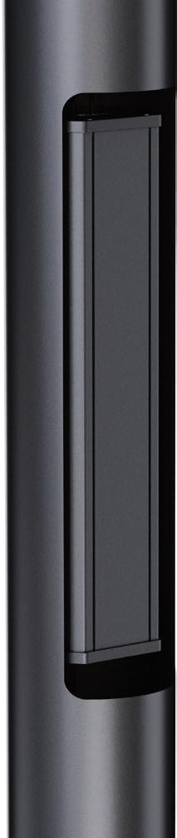
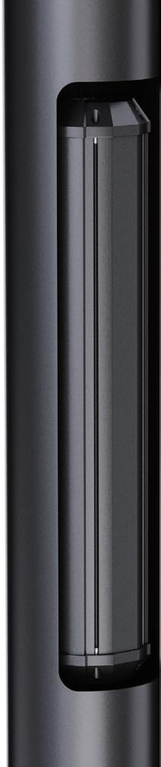
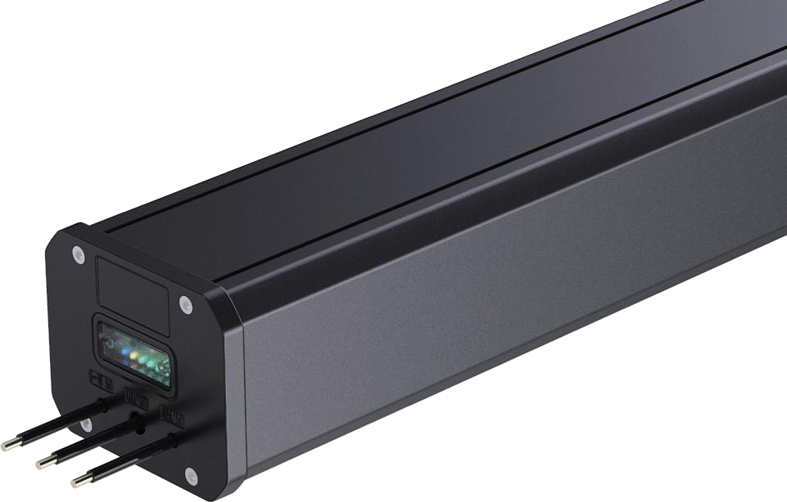
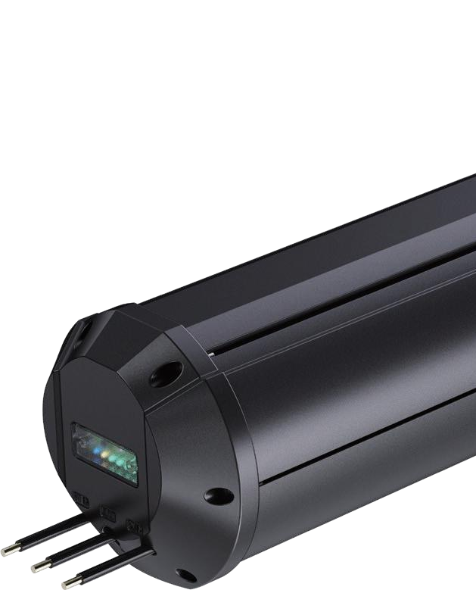
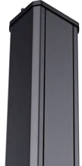
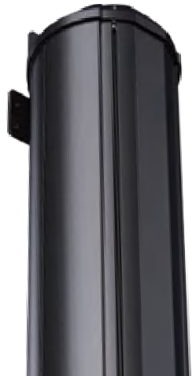
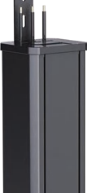
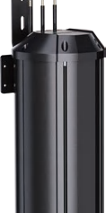
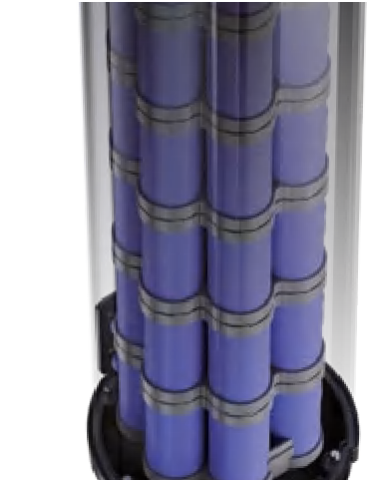
HIGHLIGHT SP-OPTR
Lithium Battery Cylinder
Built into Poles I Outside of Poles
Introducing the S&R Series Lithium Battery Pack – the ultimate power solution tailored for outdoor lighting and versatile Applications. Designed to fit seamlessly within lamp poles, the S & R Series redefines efficiency and durability, making it the perfect choice for solar streetlights, solar-powered surveillance systems, and solar advertising displays.
Crafted with a robust aluminum alloy casing and an IP67 waterproof rating, this battery pack is built to withstand the toughest environmental challenges. Its customizable capacity ensures it adapts to your unique energy needs, delivering unmatched performance.
Whether powering outdoor systems or providing rapid indoor electricity supply, the S & R Series guarantees reliability and flexibility. Elevate your projects with this state-of-the-art energy solution, engineered for excellence in every detail.
8/12

Slide 9
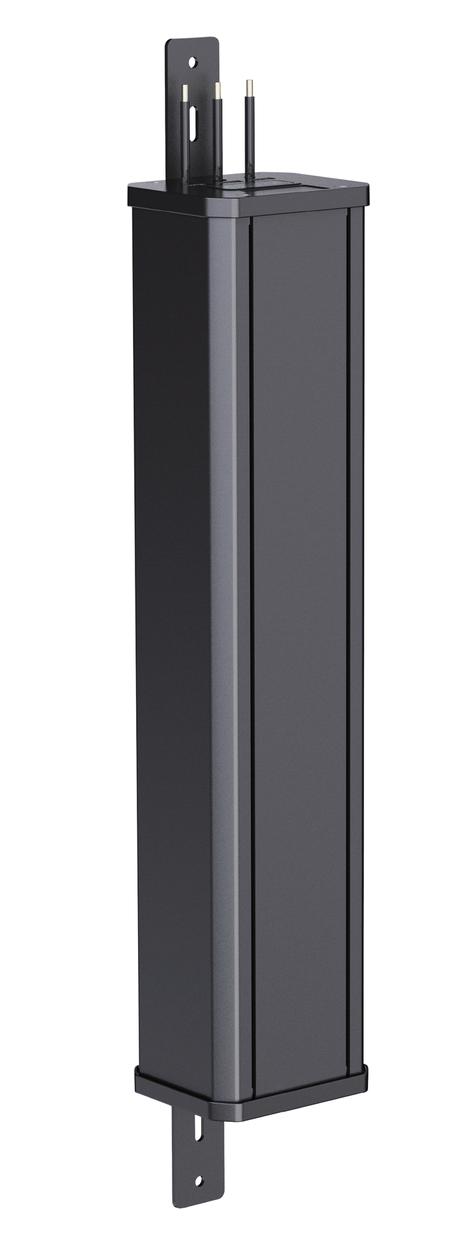
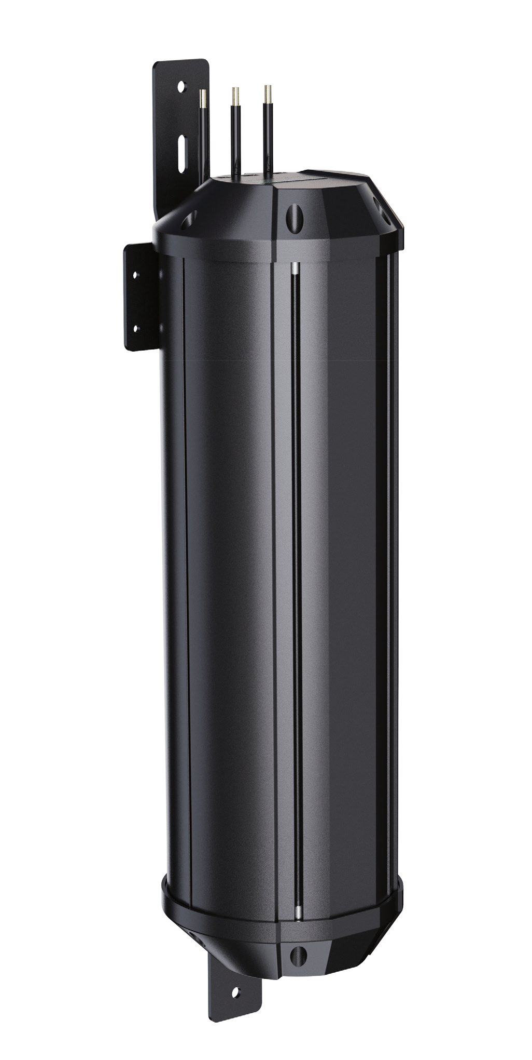
HIGHLIGHT SP-OPTR
Lithium Battery Cylinder
S Series
LiFePO4 Lithium Battery Cylinder
Battery Spec | S1236 | S1260 | S1290 | S2560
Battery Cell | 6000mA 3.2V 32700 | ● | ● | ●
Nominal Capacity | 12.8V 36AH | 12.8V 60AH | 12.8V 90AH | 25.6V 60AH
Battery Cell Quantity | 24 pieces | 40 pieces | 52 pieces | 80 pieces
Array Mode | 6P4S | 10P4S | 13P4S | 10P8S
Dimension ( L*W*H) | 12.59”*4.92”*4.25” | 20.07”*4.92”*4.25” | 27.95”*4.92”*4.25” | 36.22”*4.92”*4.25”
Net Weight | 9.03lbs | 11.68lbs | 18.07lbs | 27.55lbs
Charge Mode | C.C + C.V | ● | ● | ●
Charge Cut-off Vol | 14.6±0.05V | ● | ● | ●
Discharge Cut-off Volt | 11±0.05V | ● | ● | ●
Storage Temperature | 41F～95F | ● | ● | ●
Operating Temperature | 5F～+113F | ● | ● | ●
Lifetime ( D.OD. 60%) | 4,000 cycles | ● | ● | ●
Warranty | 3 Years | ● | ● | ●
R Series
LiFePO4 Lithium Battery Cylinder
Battery Spec | R1260 | R1290 | R2460 | R2490
Battery Cell | 15000mA 3.2V 32140 | ● | ● | ●
Nominal Capacity | 12.8V 60AH | 12.8V 90AH | 25.6V 60AH | 25.6V 90AH
Battery Cell Quantity | 16 pieces | 24 pieces | 32 pieces | 40 pieces
Array Mode | 4P4S | 6P4S | 4P8S | 5P8S
Dimension ( L*Dia) | L13.38”*D5.90” | L24.40”*D5.90” | L24.40”*D5.95” | L47.24”*D5.95”
Net Weight | 12.12lbs | 17.19lbs | 22.70lbs | 34.17lbs
Charge Mode | C.C + C.V
Charge Cut-off Voltage | 29.2±0.05V
Discharge Cut-off Voltage | 22±0.05V
Storage Temperature | 5F～95F
Operating Temperature | 5F～+113F
Lifetime ( D.OD. 60%) | 4,000 cycles
Warranty | 3 Years
9/12

Slide 10
HIGHLIGHT SP-OPTR
SOLAR STREET LIGHT
USES AND APPLICATIONS GUIDE
Streets Lighting
Parking Lots
Residential Roads
Public Parks
Sports Lighting
V
V V V V
10/12

Slide 11
HIGHLIGHT SP-OPTR
ORDERING GUIDE
Ordering Guide: EXAMPLE: HIGHLIGHT SP-OPTP-A-**RD-18V-**80W-30W-3-30K-36AH-BLK-00
Model | Solar panel Qty. | Solar panel type | Voltage | Solar panel | LED Power | Distribution type | LED Color Temp | Battery options | LED body color | Motion sensor
HIGHLIGHT SP-OPTP | A- 1 pc B- 2 pcs C- 3 pcs D- 4 pcs | **RD-Round HE-Hexagon OC- Octagon DE- Decagon DO- Dodecagon | 18V 36V | **80W **100W **140W 150W 200W 250W 300W | 30W 40W 50W 60W 80W | 4- Type IV 5 - Type V | 30K 40K 60K *Amber | 36AH 60AH 90AH | BLK- Black | 00 – No motion sensor 01 – Motion sensor
*Can customized per to customer requirement
Legal Clarification: All technical information and/or products listings and/or technical support, and/or any kind of graphics, illustrations and/or instructions and/or the names, trade names, trademarks, trade symbols, service marks, logos, icons and trade dress of SolarPath Inc or in connection to SolarPath Inc or any of its selling products, con- tainted herein is in the exclusive ownership of SolarPath Inc and may not be alternated and/or used in any manner including but not limited to copy of some or all of the said material by users and/or viewers or any third party for that matter of this document and the website to which it is linked without the express prior written permission of SolarPath Inc. Furthermore, redistribution or any kind of commercial use or alternation or any kind of use other then downloading presented information in some or all contents of downloadable documents, and/or downloadable contents, is strictly prohibited without express written prior permission. All information set out herein is subject to changes as may occur from time to time. SolarPath Inc is not responsible for, and cannot guarantee and shall not be held liable for any information or the accuracy of such in websites that it does not manage
11/12

Slide 12

Contact us
+1.201.490.4499
Toll free: 1.888.333.SOLAR (7652)
contact@solarpathusa.com
www.solarpathusa.com
12/12

