Slide 1

Architectural Solar LED Bollard
2SPBL11- Specifications

Slide 2

Why us?
2SPBL11
Innovative Technology
SolarPath is dedicated to delivering architectural and commercial-grade solar lighting that can be customized to meet specific client requests, both in technical specifications and aesthetic design, ensuring a perfect fit for a diverse range of needs.
High-efficiency solar and advanced LEDs deliver superior performance, long life, and maximum ROI.
Photometric
We conduct photometric measurements on all our products to ensure optimal performance and compliance with industry standards
Versatile Lightning
We designs and install solar-powered lightning systems tailored for all kind of locations such as streets, parks, pathways, homes, etc.
Global Reach
Worldwide success proves our adaptability and regulatory
expertise.
Sustainable Savings
These solutions enhance safety, promote sustainability and providing significant energy and cost saving.
Warranty
2/7

Slide 3
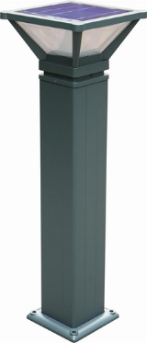
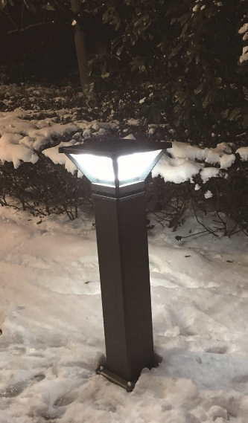
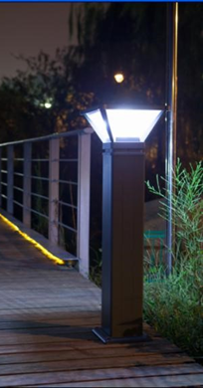
2SPBL11
The 2SPBL11 solar bollard light is an architectural independent lighting solution ideally for various applications such as parks, pathways, bike lanes, remote areas, golf courses, beach resorts, marinas, residential areas and landscape lighting projects.
The architectural patented design in combination with a robust high LED lighting output in a high-grade construction makes it your ideal choice for all your self-contained lighting projects.
2SPBL11 works completely without wiring and gets its power
from the sun, using a special energy storage system, which requires no replacement of batteries for several years.
Energy storage and usage is controlled by a unique built-in self-decisive software algorithm.
Cloudy days or shaded areas, the intelligent energy saving 2SPBL11 always provides perfect lighting conditions.
3/7

Slide 4
2SPBL11
Technical specification
Solar power | 7W
Battery capacity | 6.4V/5AH
Battery type | LifePO4 Battery, more than 2000 cycles.
Power of Lamp | 3W(Up to 500lm)
Pole height (Light included) | 31.37in
Rainy/Cloudy days | 3-5 Days
Working temperature | -4°F- 131°F
LED and optics
Life span | 50,000 hours
CCT | 3000K-6000K
Solar module
 | Monocrystalline solar panel
 | 7 watt power
 | High class mono cells
Intelligent Controls
Working time
Dusk to dawn Always dim on 30% output, when motion sensor trigger the light jump to 100% output for 30 sec (Depends on solar radiation)
Metrials
Body | Anodized Aluminum alloy
IP Rating | IP65
4/7

Slide 5
2SPBL11
ARCHITECTURAL SOLAR LED BOLLARD
USES AND APPLICATIONS GUIDE
Residential areas
Parks
Boardwalks
Resorts
Marinas
Gardens
Landscaping
Walking paths
Golf courses
Bike paths
V
V V V V V V V V V
5/7

Slide 6
2SPBL11
2SPBL11- ARCHITECTURAL SOLAR LED BOLLARD
ORDERING GUIDE
SERIES
LED COLOR
DIMMING
FINISH
HEIGHT
2SPBL11
30K- 3,000K
40K- 4,000K
50K- 5,000K
60K- 6,000K
00- No motion sensor
01- With motion sensor
BLK- BLACK (Standard)
GR- Grey
*Other colors available-MOQ-25pcs
31.37”
Legal Clarification: All technical information and/or products listings and/or technical support, and/or any kind of graphics, illustrations and/or instructions and/or the names, trade names, trademarks, trade symbols, service marks, logos, icons and trade dress of SolarPath Inc or in connection to SolarPath Inc or any of its selling products, con- tainted herein is in the exclusive ownership of SolarPath Inc and may not be alternated and/or used in any manner including but not limited to copy of some or all of the said material by users and/or viewers or any third party for that matter of this document and the website to which it is linked without the express prior written permission of SolarPath Inc. Furthermore, redistribution or any kind of commercial use or alternation or any kind of use other then downloading presented information in some or all contents of downloadable documents, and/or downloadable contents, is strictly prohibited without express written prior permission. All information set out herein is subject to changes as may occur from time to time. SolarPath Inc is not responsible for, and cannot guarantee and shall not be held liable for any information or the accuracy of such in websites that it does not manage
6/7

Slide 7

Contact us
+1.201.490.4499
Toll free: 1.888.333.SOLAR (7652)
contact@solarpathusa.com
www.solarpathusa.com
7/7

